Slide 1
Delegates and Events

Slide 2
Delegates and Events
C# - Delegate
C# - Event
Anonymous Method

Slide 3
C# - Delegate

Slide 4
C# - Delegate
A function can have one or more parameters of different data types, but what if you want to pass a function itself as a parameter?
How does C# handle the callback functions or event handler?
The answer is - delegate.
A delegate is like a pointer to a function. It is a reference type data type and it holds the reference of a method. All the delegates are implicitly derived from System.Delegate class.

Slide 5
C# - Delegate
A delegate can be declared using delegate keyword followed by a function signature as shown below.
Example: Declare delegate
<access modifier> delegate <return type> <delegate_name>(<parameters>)
The PrintSomething delegate shown above, can be used to point to any method that has same return type & parameters declared with PrintSomething.

Slide 6
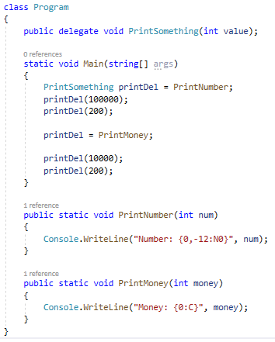

C# - Delegate. Example
We have declared PrintSomething delegate that accepts int type parameter and returns void. In the Main() method, a variable of PrintSomething type is declared and assigned a PrintNumber method name. Now, invoking PrintSomething delegate will in-turn invoke PrintNumber method. In the same way, if the PrintSomething delegate variable is assigned to the PrintMoney method, then it will invoke the PrintMoney method.
declare delegate
PrintSomething delegate points to PrintNumber or
PrintSomething delegate points to PrintMoney

Slide 7
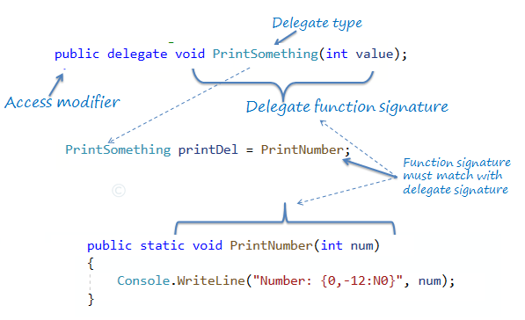
C# - Delegate
delegate in C#

Slide 8
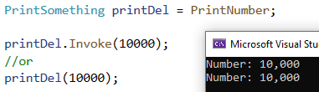
Invoking Delegate
The delegate can be invoked like a method because it is a reference to a method. Invoking a delegate will in-turn invoke a method which it refered to.
The delegate can be invoked by two ways:
using () operator;
using the Invoke() method of delegate.

Slide 9
Pass Delegate as a Parameter
A method can have a parameter of a delegate type and can invoke the delegate parameter.
PrintHelper method has a delegate parameter of PrintSomething type and invokes it like a function:
delegateFunc(numToPrint)

Slide 10
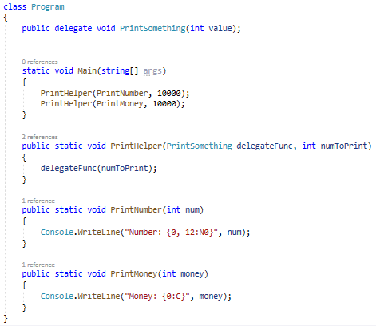

Pass Delegate as a Parameter
Example shows how to use PrintHelper method that includes delegate type parameter.

Slide 11
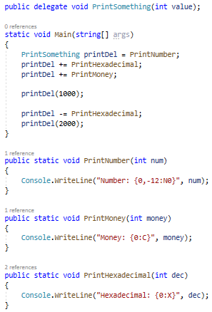

Multicast Delegate
The delegate can points to multiple methods.
A delegate that points multiple methods is called a multicast delegate.
The "+" operator adds a function to the delegate object and the "-" operator removes an existing function from a delegate object.
In the example, PrintSomething delegates becomes a multicast delegate because it points to three methods - PrintNumber, PrintMoney & PrintHexadecimal. So invoking printDel will invoke all the methods sequentially.

Slide 12
Delegates. Summary
Delegate is a function pointer. It is reference type data type.
Syntax:
public delegate void <function name>(<parameters>)
A method that is going to assign to delegate must have same signature as delegate.
Delegates can be invoke like a normal function or Invoke() method.
Multiple methods can be assigned to the delegate using "+" operator. It is called multicast delegate.

Slide 13
C# - Event

Slide 14
C# - Event
Events in C# follow a similar concept.
An event has a publisher, subscriber, notification and a handler.
Generally, UI controls use events extensively. For example, the button control in a Windows form has multiple events such as click, mouseover, etc.
A custom class can also have an event to notify other subscriber classes about something that has happened or is going to happen.
Notes:
In general terms, an event is something special that is going to happen. For example, Microsoft launches events for developers, to make them aware about the features of new or existing products. Microsoft notifies the developers about the event by email or other advertisement options. So in this case, Microsoft is a publisher who launches (raises) an event and notifies the developers about it and developers are the subscribers of the event and attend (handle) the event.

Slide 15


C# - Event
An event is nothing but an encapsulated delegate. You can declare the delegate as shown below:
Now, to declare an event, use the event keyword before declaring a variable of delegate type, as below:
Notes:
As we have learned in the previous section, a delegate is a reference type data type.
Thus, a delegate becomes an event using the event keyword.

Slide 16
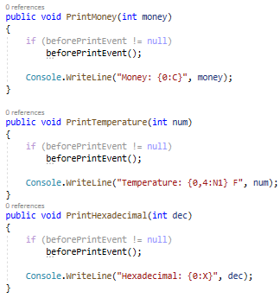
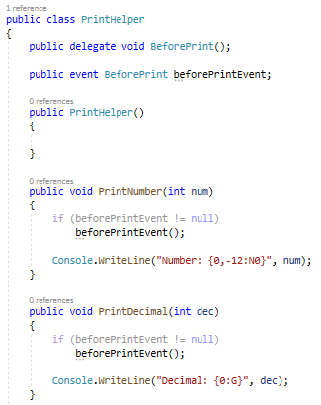
C# - Event. Example
declare delegate
declare event of type delegate
call delegate method before going to print
Consider the following PrintHelper class that prints integers in different formats like number, money, decimal, temperature and hexadecimal. It includes a beforePrintEvent to notify the subscriber of the BeforePrint event before it going to print the number.
Notes:
PrintHelper is a publisher class that publishes the beforePrint event.
Notice that in each print method, it first checks to see if beforePrintEvent is not null and then it calls beforePrintEvent().
beforePrintEvent is an object of type BeforPrint delegate, so it would be null if no class is subscribed to the event and that is why it is necessary to check for null before calling a delegate.

Slide 17
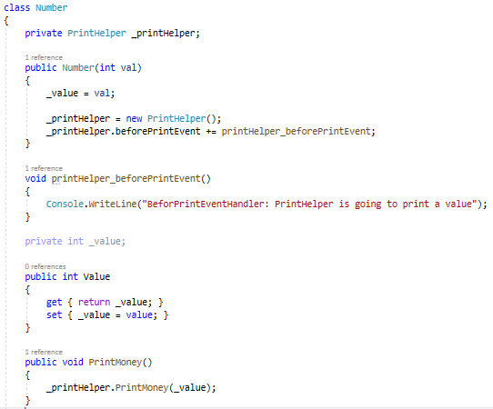

C# - Event. Event Subscriber
subscribe to beforePrintEvent event
beforePrintevent handler
The Number class creates an instance of PrintHelper and subscribes to the beforePrintEvent with the "+=" operator and gives the name of the function which will handle the event (it will be get called when publish fires an event). printHelper_beforePrintEvent is the event handler that has the same signature as the BeforePrint delegate in the PrintHelper class.
Notes:
All the subscribers must provided a handler function, which is going to be called when a publisher raises an event.

Slide 18


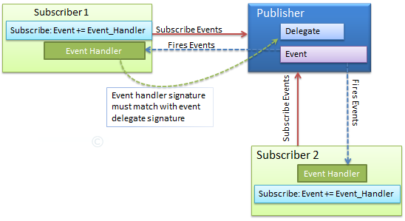
C# - Event. Example
So now, create an instance of Number class and call print methods:
The following
image illustrates
an event model:

Slide 19
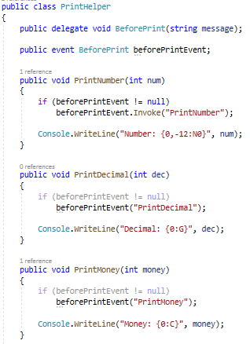
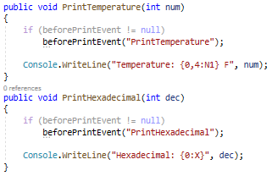
Event Arguments
Events can also pass data as an argument to their subscribed handler. An event passes arguments to the handler as the delegate signature.
Notes:
In the example, PrintHelper declares the BeforePrint delegate that accepts a string argument. So now, you can pass a string when you raise an event from PrintNumber or any other Print method.

Slide 20


Event Arguments
In the example, Number class has a printHelper_beforePrintEvent function with string parameter.
Notes:
Now, the subscriber class should have an event handler that has a string parameter.

Slide 21
Events. Summary
Use event keyword with delegate type to declare an event.
Check event is null or not before raising an event.
Subscribe to events using "+=" operator. Unsubscribe it using "-=" operator.
Function that handles the event is called event handler. Event handler must have same signature as declared by event delegate.
Events can have arguments which will be passed to handler function.
Events can also be declared static, virtual, sealed and abstract.
Events will not be raised if there is no subscriber
Event handlers are invoked synchronously if there are multiple subscribers

Slide 22
Task
Create Delegate void MyDel (int m)
Create class Student with names and marks (a type of list <int>), event MarkChange of the type MyDel and the method AddMark (adds a new mark to the list of marks).
Create class Parent with the method OnMarkChange (which receives an int estimate and displays it on the console)
In Main, create a student, parent, sign the parent method of OnMarkChange on the student event MarkChange. Call the method AddMark several times.
Create a class Accountancy, a method of PayingFellowship (which prints will be a student have a scholarship or not). Sign this method on the student event MarkChange

Slide 23
Thank You

